Slide 1
AutoConnect Inc.

Slide 2







AutoConnect Team
Arunima AGRAWAL
Data Scientist
Aishwarya CHOUKEKAR
Data Analyst
Louis D'HULST
Product Owner
Fatima NADEEM
Business Analyst
Arpit NAGPAL
Product Managerr
Smitul SONI
Data Scientist
Shehryar HUSSAIN
Business Analyst

Slide 3


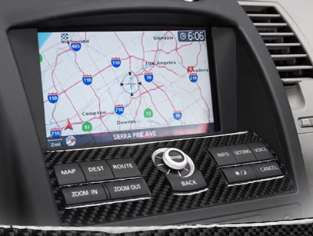

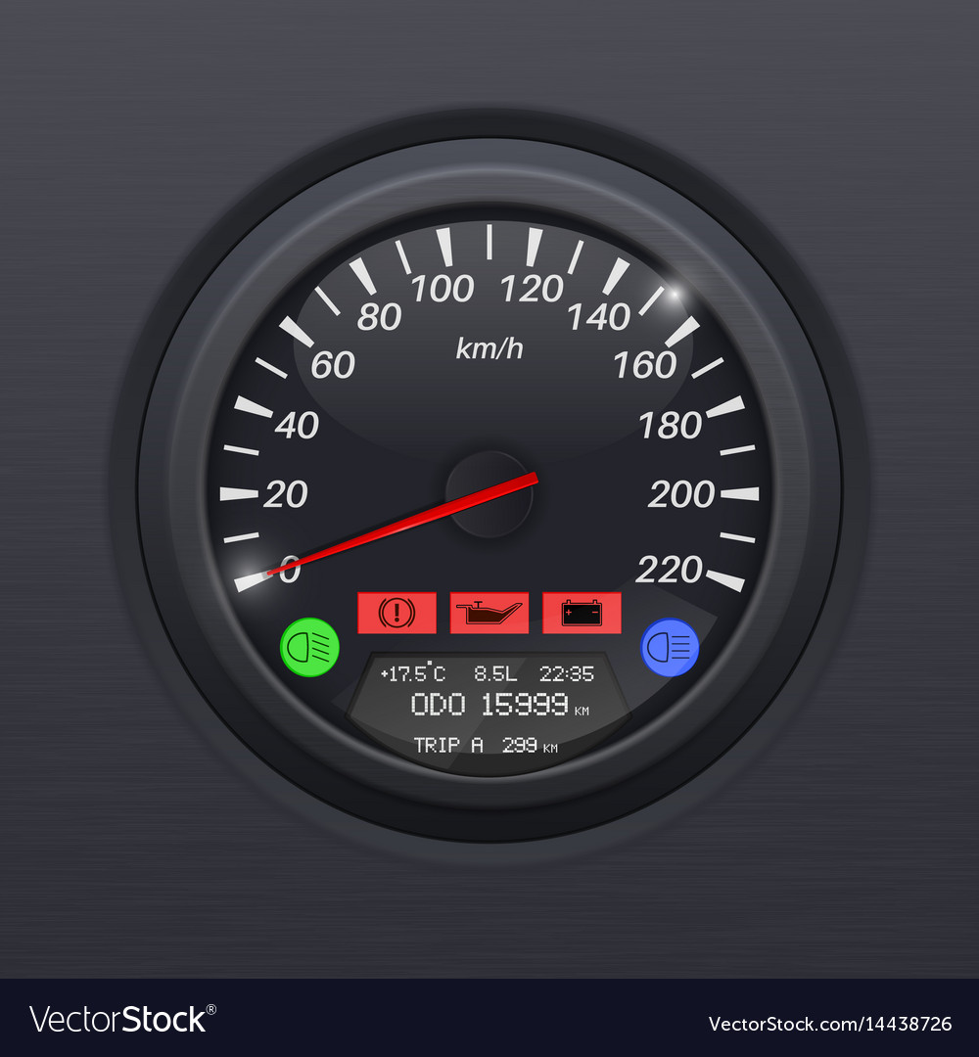

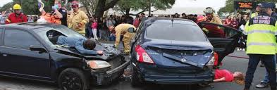
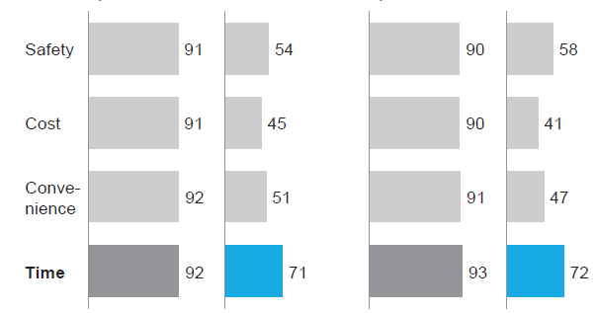
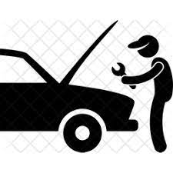


Car Data
Market Outlook - McKinsey Report
Real-time car data about how they are, where they are and who is behind the wheel
70%
US users willing to share personal data
External Conditions
Location
Driver Personal Data
Technical Status
⅔
interested in getting greater safety, convenience, & cost-saving through sharing car data
450 BN
estimated global value of car generated data market by 2030
Monetizing Car Data to create new service business opportunities and customer benefits
Privacy Sensitivity
Live Road Conditions Reported
Our Scope
User Willingness to Share Data
External (GPS, Weather data)
Low
Targeted Advertisements
E-Commerce on the move
Purpose of Collection
(N=546)
Car Usage (Speed, Weight, Mileage)
Proactive Real-Time Communication between Drivers
Predictive Insurance & Service Bookings
Personal (Identity, preferences, use patterns)
Germany
US
High
Notes:
Our company revolves around leveraging car data. So what is Car Data? It is any data generated about the car itself, how it is and where it is and about the drivers, their behaviours and preferences. This past and real - time data can be monetized and various services can be offered through predictive and prescriptive analysis to create value for the users. McKinsey also explored the car data market and estimated it to have a global value of 450 billion by 2030. However, such kinds of customer data is always accompanied by privacy issues and through research, it is determined that data on location and car usage and status has relatively lower sensitivity but users are quite reluctant to share personal data. Keeping such considerations in mind, Louis will go on to talk about our initial proof of concept and product road map

Slide 4
In-Vehicle Advertisement Through Coupons
A Positive Partnership with Users

Slide 5


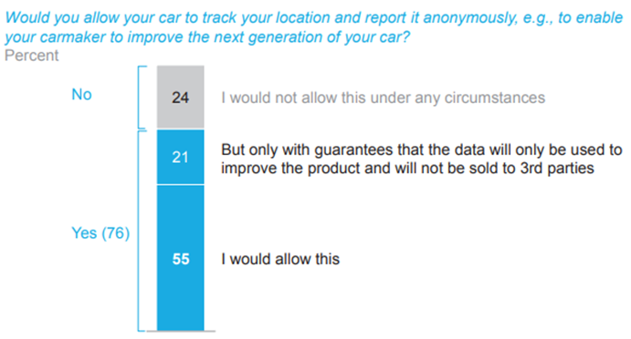

Data as a Currency
Proof Of Concept
Coupons reward customers for participation
Users pay us with data, we provide coupons they want
Privacy Sensitivity: build a trust-based partnership to ensure access to more data
Data collection through phone App
Initial Targeting through location & weather data
Customized Coupon Advertisement
Notes:
Our proof of concept: provide in-vehicle advertising via coupons.
Why coupons? As mentioned people are sensitive to privacy concerns, but are more willing to share data when they get something in return
Coupons provide a cost incentive for customers, especially when they are targeted to increase the likelihood of them being accepted and then used
Initial product could be an app on your phone, uses location and weather data to recommend certain coupons (location is most important)
So we turn data into a currency, incentivise customers to trust us => so we can collect more private data
For example, when pulling up into a grocery store the app could pull up certain coupons
Benefit for consumer: see deals they might have missed out on
Benefit for grocery store: customer goes into store with products in mind, more likely to purchase more

Slide 6
Stakeholder Map
Car Companies
Want to enter the car data space
Concerned with lack of agility needed to leverage data
Car Manufacturers
AutoConnect
Inc.
Users
Retailers
Drivers
Provide us with data, receive targeted coupons
Concerned with data privacy
Want something in return for data
Restaurants
Passengers
Advertisers
Want to reach customers
Concerned with efficiency of marketing spending
Notes:
We are at the intersection between 3 stakeholders
Advertisers: groups that would advertise new products/promotions through us
Our main initial revenue stream
We act as intermediary between advertisers and users
Want to reach customers and draw them to their stores, are concerned with the efficiency of marketing spending: we ensure this by providing targeted advertising
Users: people using our app and getting coupon deals
Provide us with data so we can make informed decisions (targeting)
Concerned with the privacy of their data, want to give as little as possible
At the same time want to receive something in return for what they give: in this case cost reduction
Car manufacturers: they want to enter the car data space and utilize the data being generated by drivers and passengers
However, they are often too rigid and lack the agility/rapidity needed to develop data analytics product and continuously improve them
Are therefore looking towards Big Tech firms and start ups to fill the gap and bring them onto the analytics scene
We provide a less tangible form of value to them
Their cooperation is important but not necessary for us

Slide 7





Product Roadmap
Additional Features and Target Customer Diversification
Product Usability Improvements
Agile Learning Launches
In- Vehicle Coupon Recommendation Model Enhancement
Horizontal Industry Expansion
Notes:
The future roadmap of the product is defined to map the transition from In-Vehicle Coupon Recommendation Proof-of-Concept for F&B based on the given dataset to a production level large scale V2B (Vehicle to Business) and V2X (Vehicle to Everything) Product with the following four defined phases:
Product Usability Improvements: Initial product coupon recommendation is based on real-time weather data and location data available via customer mobile devices. To enhance product usability based on the current provided data, enhance the accuracy of GPS or location data
Unsupervised learning models to create customer segments to enhance targeting
In-Vehicle Coupon Recommendation Model Enhancement: The next step is to enhance in-vehicle coupon recommendation engine to expand the recommendation system to other market players such as fuel station retailers, car washes and grocery stores . Additionally, the customers would be exposed to demographic data collection, resulting in better recommendations for F&B and e-commerce partners to introduce in-vehicle advertisements and targeted marketing strategies. These e-commerce and F&B marketing strategies would be based on collaborations based on historical data.
Additional Features and Target Customer Diversification: The next stage would be to enhance data collection strategies and accordingly enhance target customers based on the data collected. With the power of IoT, big data analytics, data cloud streaming and high-resolution positioning, the target customers are diversified from just in-vehicle drivers to automotive sector players (data feedback based R&D and warranty costs reduction), insurance firms (vehicle monitoring and scoring), traditional stores and malls (Traffic data based retail footprint and stock level optimization)
Horizontal Industry Expansion: Based on the customer target diversification, AutoConnect would enter multiple verticals using it’s data collection and analytics technology to break the vehicle data market. Moreover, in-vehicle users adoption of the product enhances due to additional product features (based on subscription) such as usage based insurance - Pay as you drive (PAYD) and Pay how you drive (PHYD), breakdown call services, enhanced vehicle service level insights based on predictive modelling and establishing a P2P carpooling network. Based on the service subscriptions, these data points would be shared with businesses and market players for monetization.
Agile Learning Launches:
What are these learning launches?
Learning launches would be designed to test the key underlying value-generating assumption of a potential new-growth initiative of our product in the marketplace.
Why use learning launches?
In contrast to a full new-product rollout, a learning launch would act as a learning experiment conducted quickly to gather real-time market-driven data and insights. These fast-paced experiments would be carried out in an agile manner i.e., in sprints or iterations for the product to fit to the user and market needs in an inexpensive and fast-paced manner.

Slide 8
Preliminary Research
Using surveys to create insights

Slide 9
Research Dataset
Amazon Mechanical Turk surveys to collect demographic data and willingness to use coupon
Classify binary response
12,000 rows
Different driving scenarios and coupon offers
Limitations to external validity
Surveys do not always reflect reality
Location data reflection of time to drive to store
Notes:
Data comes from surveys sent to highly rated Amazon Mechanical Turk users, asked willingness to use coupon in different driving scenarios and with different coupon options: ex coupon for less then 20$ at restaurant more than 20 minutes away
Dataset has potential issues with external validity: surveys don’t place people under real, constrained conditions
Our location data reflects the time it takes to drive to store and not actual location/distance

Slide 10
Data Pre-Processing
Data Cleaning
Time (24h format)
Age (50plus ->50)
Expiry (hours)
Dropping column with 90% null
Dropping column with unary values
Ordinal Features
Education
Gender
Income Bracket
Visits to Bar & CoffeeHouse
Carry Away
RestaurantLessThan20
Restaurant20To50
Vestibulum congue
Hypothesis Testing
Categorical Features
Destination
Passenger(s)
Coupon Type
Marital Status
Weather
Occupation
Imputer (median)
Bar
CoffeeHouse
CarryAway
RestaurantLessThan20
Restaurant20To50
Correlation
Vestibulum congue
Data Cleaning & pre-processing
Notes:
Present features and the pre-processing steps to transform them into
Have some demographic variables like age, education, gender, income bracket -> privacy sensitive
Categorical encoding: One Hot Encoding
Ordinal Features: Ordinal encoding depending on level
Income is a bracket, are splitting in two
Imputation to replace missing values: imputation by median
Correlation matrix: no highly correlated features
Hypothesis testing to check similarity between feature distributions: most are significantly different except for time and occupation

Slide 11
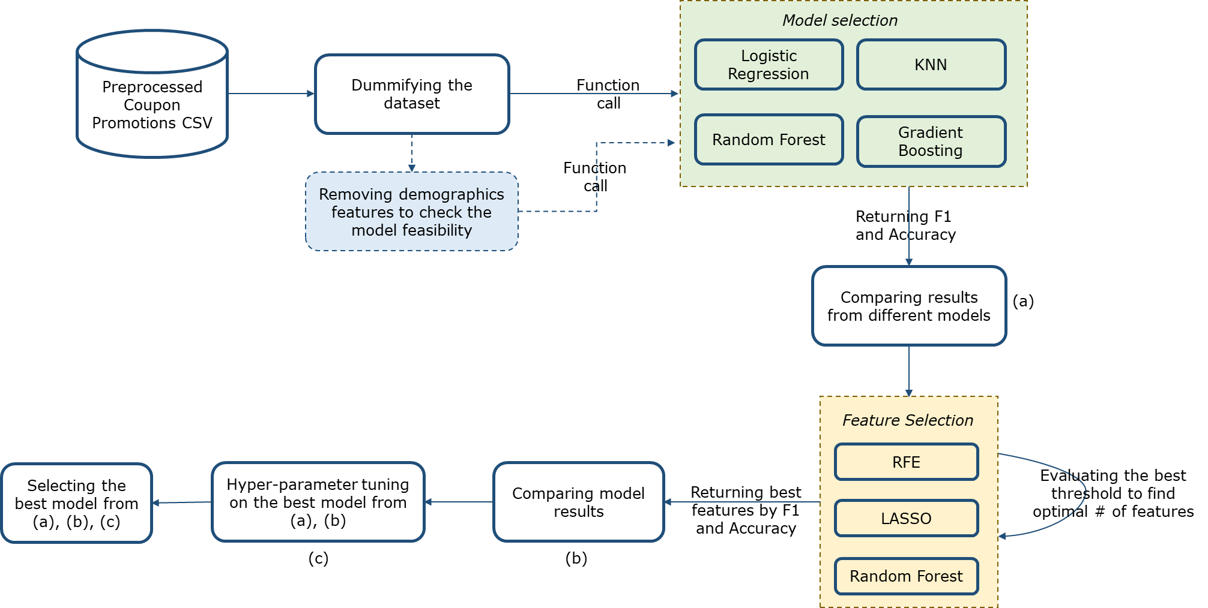
Model Pipeline

Slide 12
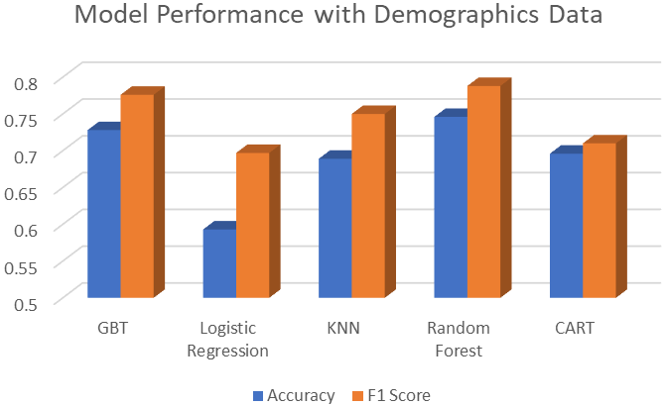
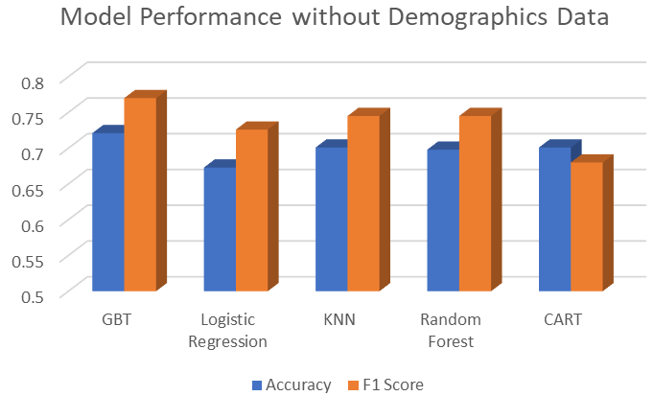
Model Evaluation
With demographics data:
Champion Model: Random Forest with Random Forest feature selection
Without demographics data:
Champion Model: Gradient Boosting with Random Forest feature selection
Notes:
With Demographics:
Random Forest Results (26 features):
Accuracy: 0.75
F1 Score: 0.79
Without Demographics:
GBT Results (18 features):
Accuracy: 0.72
F1 Score: 0.77

Slide 13
Way Forward
Demographic Data such as age and income are top predictors.
Inclusion leads to better ad customization and higher probability for customer to accept the coupon.
Create clustering model to segment customer base for further insights
The product can be further expanded to more industries and can include more recommendations for customers.

